Slide 1
Virtual Agent Implementation Plan (MVP)
MM, DD, 2024

Slide 2
Agenda
VA: Overview, scope, features
Key decisions
Testing and UAT
Go-live plan & timeline
Concerns (User acceptance, VA not responding (system freeze)
Next steps

Slide 3
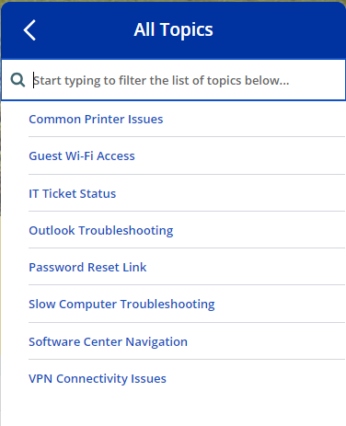
Virtual agent is a chatbot that will provide answers to user's questions and help them solve common tasks.
Virtual agent “Kernel” - Top 8 topics
Incident Deflection “Self Service”
Make user support faster and more efficient
Improve service center efficiency
Reduce workload/tickets
Improve user experience
Natural Language Understanding(NLU)
Availability
AI Search
Multi-Channel Support
Analytics and Reporting
Integration

Slide 4


Key decisions
Virtual agent name – Kernel
Virtual agent icon/profile
Chat widget
VA Conversation
KB articles
Topic flow
Links
Photos (ScreenShots)
Messages
Cross training
Pilot user group
Timelines
Marketing & Communication
Go live target date Dec 9/10

Slide 5
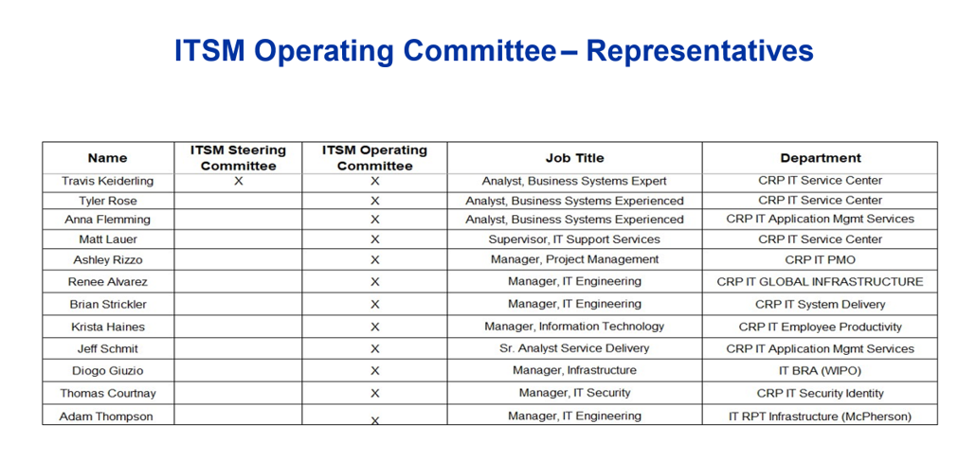
For the Chat Bot pilot – I would like to start with IT users and then consider adding a few business users.
For IT , let’s go with everyone on this email as well as utilize our ITSM operating committee members. I have attached those folks below. I will work with Travis to message their role in the pilot back to them

Slide 6
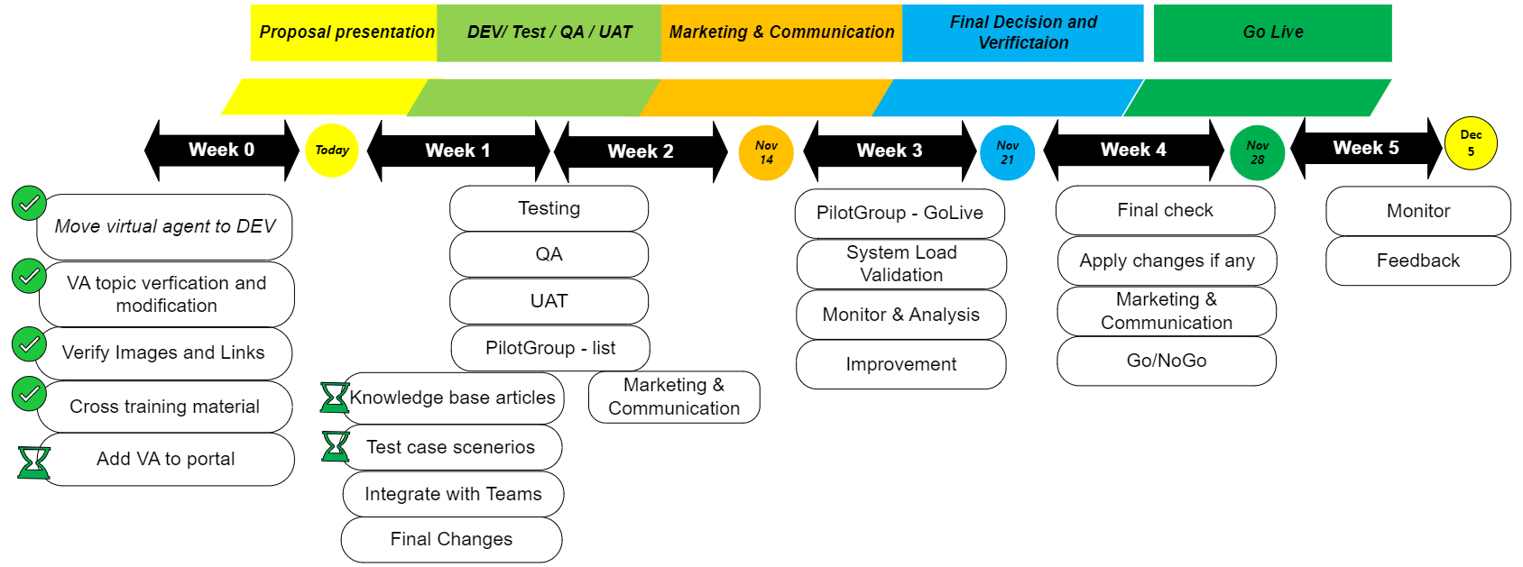
Proposed Timeline

Slide 7
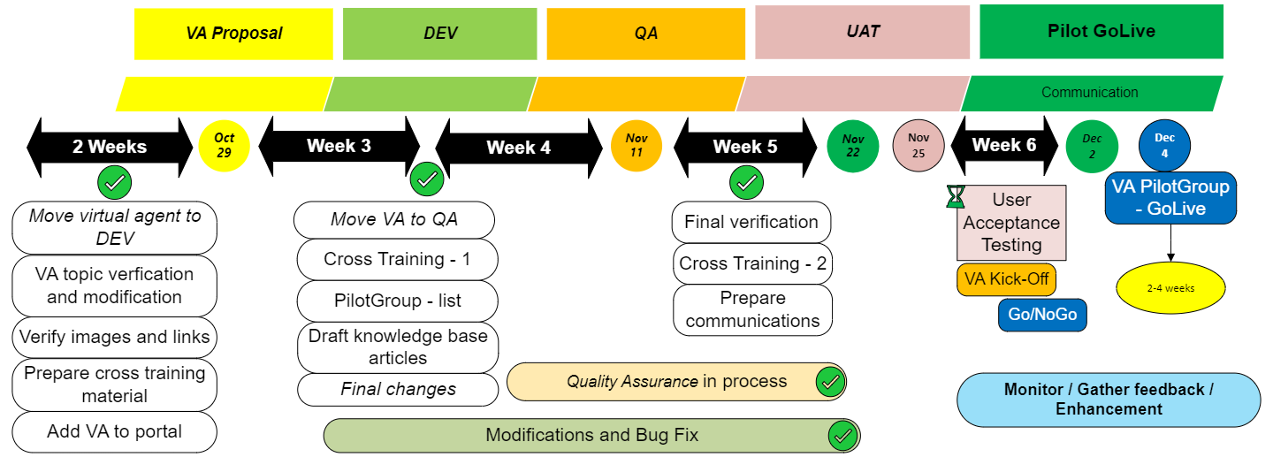
Proposed Timeline (updated)

Slide 8
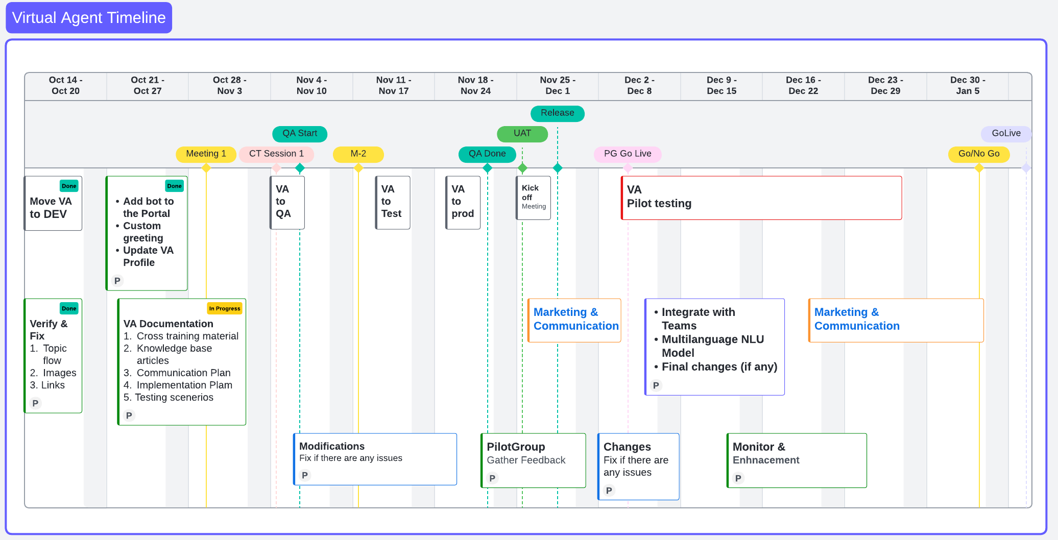
Final Timeline

Slide 9
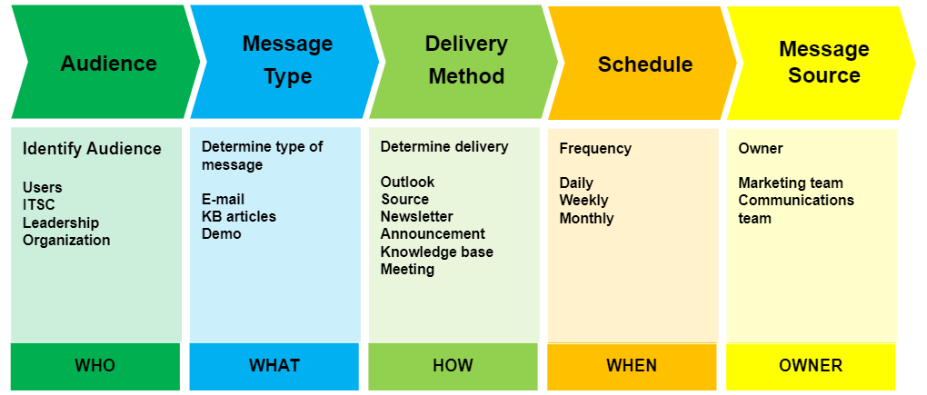
Virtual Agent Go Live Communication Plan

Slide 10
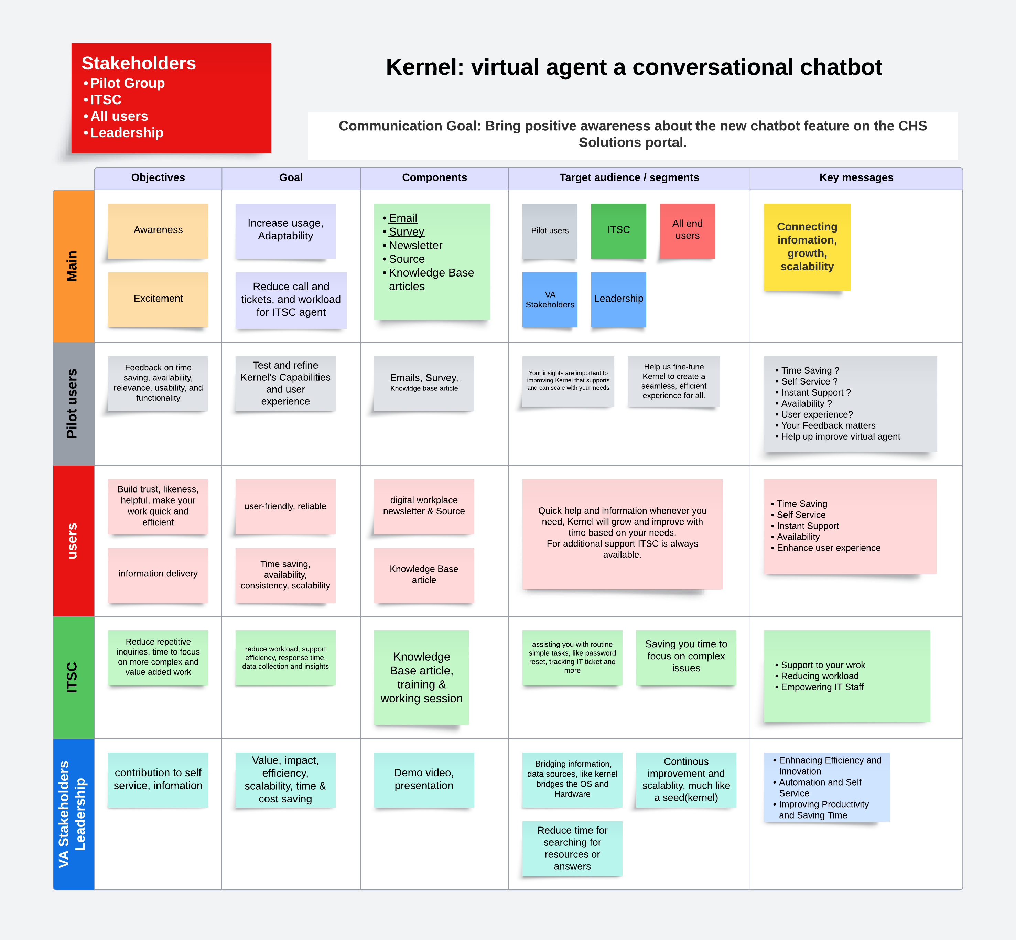

Slide 11
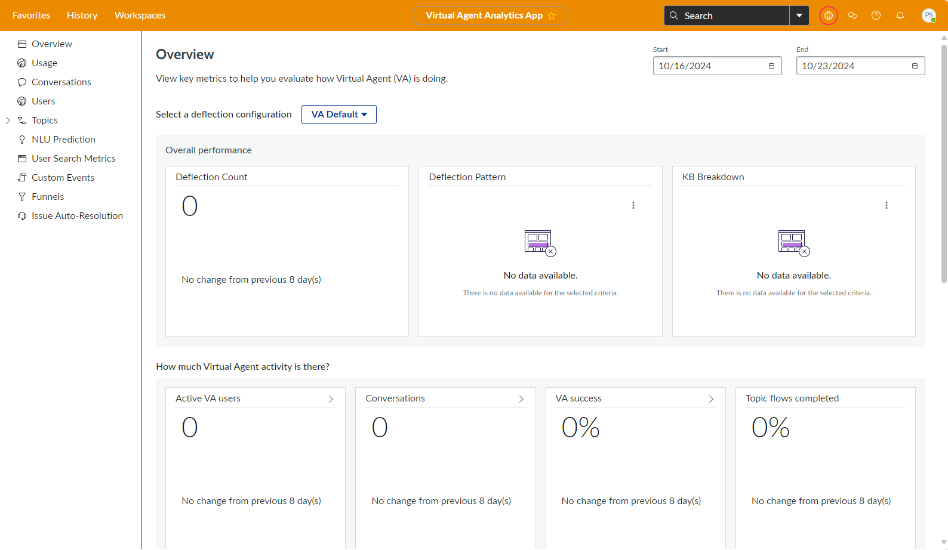
Success Metrics
Conversational Analytics
Virtual Agent Dashboard
User Adoption rate: Measure how many users are actively using the virtual agent.
Deflection rate: Percentage of issues resolved by the virtual agent without needing agent intervention.
ITSC Deflection rate: The interactions that the virtual agent deflecting to ITSC live agent.
Error/Accuracy rate: Track the number of incorrect/accurate responses.
Engagement metrics
Positive user feedback
Time savings: Estimate time reduction due to the virtual agent handling tasks.

Slide 12
Forward-Looking Statements
This document and other CHS Inc. publicly available documents contain, and CHS officers and representatives may from time to time make, "forward-looking statements" within the meaning of the safe harbor provisions of the U.S. Private Securities Litigation Reform Act of 1995. Forward-looking statements can be identified by words such as "anticipate," "intend," "plan," "goal," "seek," "believe," "project," "estimate," "expect," "strategy," "future," "likely," "may," "should," "will" and similar references to future periods. Forward-looking statements are neither historical facts nor assurances of future performance. Instead, they are based only on CHS current beliefs, expectations and assumptions regarding the future of its businesses, financial condition and results of operations, future plans and strategies, projections, anticipated events and trends, the economy and other future conditions. Because forward-looking statements relate to the future, they are subject to inherent uncertainties, risks and changes in circumstances that are difficult to predict and many of which are outside of CHS control. CHS actual results and financial condition may differ materially from those indicated in the forward-looking statements. Therefore, you should not place undue reliance on any of these forward-looking statements. Important factors that could cause CHS actual results and financial condition to differ materially from those indicated in the forward-looking statements are discussed or identified in CHS filings made with the U.S. Securities and Exchange Commission, including in the "Risk Factors" discussion in Item 1A of CHS Annual Report on Form 10-K for the fiscal year ended August 31, 2022, as supplemented by the "Risk Factors" discussion in our Quarterly Report on Form 10-Q for the quarter ended February 28, 2023. These factors may include: changes in commodity prices; the impact of government policies, mandates, regulations and trade agreements; global and regional political, economic, legal and other risks of doing business globally; the ongoing war between Russia and Ukraine; the impact of inflation; the impact of epidemics, pandemics, outbreaks of disease and other adverse public health developments, including COVID-19; the impact of market acceptance of alternatives to refined petroleum products; consolidation among our suppliers and customers; nonperformance by contractual counterparties; changes in federal income tax laws or our tax status; the impact of compliance or noncompliance with applicable laws and regulations; the impact of any governmental investigations; the impact of environmental liabilities and litigation; actual or perceived quality, safety or health risks associated with our products; the impact of seasonality; the effectiveness of our risk management strategies; business interruptions, casualty losses and supply chain issues; the impact of workforce factors; our funding needs and financing sources; financial institutions’ and other capital sources’ policies concerning energy-related businesses; uncertainty regarding the transition away from LIBOR and the replacement of LIBOR with an alternative reference rate; technological improvements that decrease the demand for our agronomy and energy products; our ability to complete, integrate and benefit from acquisitions, strategic alliances, joint ventures, divestitures and other nonordinary course-of-business events; security breaches or other disruptions to our information technology systems or assets; the impact of our environmental, social and governance practices, including failures or delays in achieving our strategies or expectations related to climate change or other environmental matters; the impairment of long-lived assets; the impact of bank failures; and other factors affecting our businesses generally. Any forward-looking statements made by CHS in this document are based only on information currently available to CHS and speak only as of the date on which the statement is made. CHS undertakes no obligation to update any forward-looking statement, whether written or oral, that may be made from time to time, whether as a result of new information, future developments or otherwise except as required by applicable law.
Notes:
Before we get started, please take a moment to review this slide, which has important information for our time together. Some of the business and financial topics we discuss may be considered forward–looking statements under United States securities laws. It’s important to understand that actual events and results could differ from our comments today.

